Slide 1














Schools

Slide 2

INTRODUCTION
This project is designed to manage student data within an educational framework, specifically tailored for SRM-AP's implementation of Outcome-Based Education (OBE). The system provides an intuitive interface for storing, viewing, updating, and deleting student records. Key attributes include student ID, name, grade, and a description, which are essential for maintaining structured and accessible information about each student. The system ensures users can efficiently manage these records by offering comprehensive functions to create, modify, and delete student data as needed.
To optimize data organization and performance, this project incorporates efficient sorting and searching algorithms. Sorting methods include Merge Sort, valued for its stability and consistent performance, ensuring efficient handling of large datasets. For quick lookups, Binary Search is implemented, which allows users to swiftly retrieve records within sorted data. The inclusion of these algorithms not only enhances data integrity but also provides users with multiple tools for accessing and organizing student data effectively.
By integrating these sorting and searching capabilities, the project exemplifies OBE principles by providing a robust, outcome-focused system that supports efficient and reliable data management, directly aligning with SRM-AP’s educational goals.

Slide 3
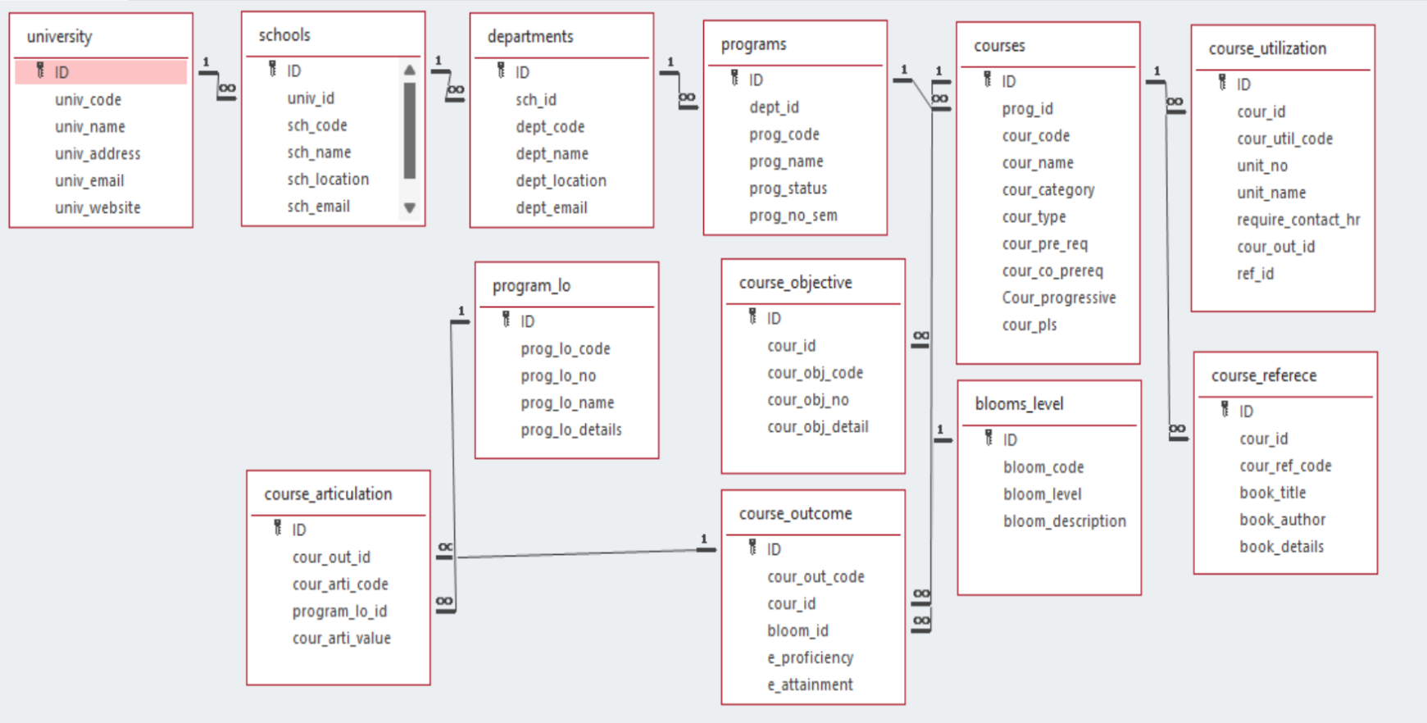

Slide 4
Module Description
This C program module is designed for managing "schools," which are university data entries that include details such as univ_id, sch_code, sch_name, sch_location, and sch_email. The data is stored in a text file (schools.txt) to ensure persistence across sessions. Upon startup, the program loads existing data from the file into memory, allowing users to manage school records through a command-line interface. After any addition, deletion, or update, changes are saved back to the text file, maintaining reliable data storage.
The module provides CRUD (Create, Retrieve, Update, Delete) operations, enabling users to:
Create: Add new school records.
Retrieve: Display all stored school records.
Update: Modify existing records based on school name.
Delete: Remove specific school records by name.
For data manipulation, the module includes sorting and searching functionalities to help organize and locate records efficiently. Sorting is achieved through the Merge Sort algorithm, which organizes schools by name and provides stable sorting with O(n log n) time complexity. Binary Search is implemented to quickly locate records, with a time complexity of O(log n).
The program also compares the time complexities of implemented sorting algorithms, allowing users to understand the efficiency of each operation. This feature provides an educational aspect to the module, helping users comprehend the performance advantages and disadvantages of the chosen algorithms.

Slide 5
FIELD DETAILS
SNO | Field Name | Data type
1 | ID | char
2 | sch_code | char
3 | sch_name | char
4 | sch_location | char
5 | sch_email | char

Slide 6
School Setting:Programming Details
File name: yourregno_school_module
Function/Method Name Mapping:
Create: void titans_school_create();
Update: void titans_school_update();
Retrieve: void titans_school_retrieve();
Delete: void titans_school_delete();
Sorting: void titans_school_merge_sort(int left, int right);
Searching: int titans_school_linear_search(const char *sch_name);

Slide 7
School: Programming Details
Comparison(both searching and Sorting):
Searching int sunrisers_compare_search_binarysearch(int id);
Sorting void sunrisers_compare_sort_mergesort(int left, int right);
Time Complexity:
Searching-void sunrisers_complexity_searching();
Sorting-void sunrisers_complexity_sorting();

Slide 8
School: SortingAlgorithm Used
Quick sort
MERGE SORT
QuickSort(arr[], low, high)
if low < high
pivot = Partition(arr[], low, high)
QuickSort(arr[], low, pivot - 1)
QuickSort(arr[], pivot + 1, high)
Partition(arr[], low, high)
pivot = arr[high]
i = low - 1
for j = low to high - 1
if arr[j] is less than pivot based on the sorting criteria
swap arr[i] with arr[j]
i++
swap arr[i + 1] with arr[high]
return i + 1
void sunrisers_schools_merge(int left, int mid, int right) {
int n1 = mid - left + 1, n2 = right - mid;
School *L = malloc(n1 * sizeof(School)), *R = malloc(n2 * sizeof(School));
for (int i = 0; i < n1; i++) L[i] = schools[left + i];
for (int i = 0; i < n2; i++) R[i] = schools[mid + 1 + i];
int i = 0, j = 0, k = left;
while (i < n1 && j < n2)
schools[k++] = strcmp(L[i].sch_name, R[j].sch_name) <= 0 ? L[i++] : R[j++];
while (i < n1) schools[k++] = L[i++];
while (j < n2) schools[k++] = R[j++];
free(L); free(R);
}
void sunrisers_schools_merge_sort(int left, int right) {
if (left < right) {
int mid = left + (right - left) / 2;
sunrisers_schools_merge_sort(left, mid);
sunrisers_schools_merge_sort(mid + 1, right);
sunrisers_schools_merge(left, mid, right);
}
}

Slide 9
School :Comparision of Sorting Algorithm
Quick Sort:
Approach: Uses a pivot, partitions array into smaller and larger elements, then recursively sorts.
Time Complexity: Best and Average: O(nlog⁡n) ; Worst: O(n^2).
Space Complexity: O(log⁡n) (in-place).
Applications: Generally faster for large, randomly accessed datasets. Not stable.
Merge Sort:
Approach: Divides array into two halves, recursively sorts, then merges sorted halves.
Time Complexity: O(nlog⁡n) for all cases.
Space Complexity: O(n) (uses extra space for merging).
Applications: Suitable for linked lists, stable sorting, and large external datasets.

Slide 10
School: Time Complexity Of Sorting
Algorithm
Quick Sort
Best Case: O(nlog⁡n) — Pivot divides array into nearly equal halves.
Average Case: O(nlog⁡n) — Pivot generally gives balanced splits.
Worst Case: O(n^2) — Pivot repeatedly gives unbalanced splits (e.g., sorted array)
Merge Sort
Best, Average, Worst Case: O(nlog⁡n) — Always splits array into two equal halves and merges, so performance remains stable regardless of data order.
Why Merge Sort is Consistent:
Since it does not depend on pivot selection, Merge Sort’s performance remains unaffected by the initial order of elements. It always divides evenly, ensuring balanced recursion in all cases.

Slide 11
LINEAR SEARCH
LinearSearch(arr[], target_code, target_name, target_email)
for each element in arr[]
if element's code == target_code
and element's name == target_name
and element's email == target_email
return index
return -1
BINARY SEARCH
BinarySearch(arr[], target_code, target_name, target_email)
left = 0
right = arr.length - 1
while left <= right
mid = (left + right) / 2
if arr[mid] matches target based on code, name, and email
return mid
else if arr[mid] is less than target based on sorting criteria
left = mid + 1
else
right = mid - 1
return -1

Slide 12
School : Comparison Of Searching Algorithm
Binary Search
Approach: Repeatedly divides a sorted list in half, checking if the target is in the left or right half.
Time Complexity:
Best Case: O(1)O(1) — Target is the middle element.
Average/Worst Case: O(log⁡n)O(logn) — Reduces search space by half each time.
Requirements: Requires a sorted list.
Use Case: Efficient for large, sorted datasets.
Linear Search
Approach: Sequentially checks each element in the list until the target is found
Time Complexity:
Best Case: O(1)O(1) — Target is the first element.
Average/Worst Case: O(n)O(n) — Target is in the middle or not present.
Requirements: Works on both sorted and unsorted lists.
Use Case: Good for small or unsorted datasets.

Slide 13
School: Time Complexity of Searching Algorithm
Linear Search
Best Case: O(1) — Target found at the start.
Average Case: O(n)— Searches about halfway through.
Worst Case: O(n) — Searches entire list if target is at the end or absent
Binary Search
Best Case: O(1)— Target is the middle element on the first try.
Average Case: O(log⁡n)— Continuously halves the list until found.
Worst Case: O(log⁡n) — Full list division until target is found or confirmed absent.
Binary search is better for large, sorted datasets because it has O(log⁡n) time complexity. By halving the search space each step, it finds the target much faster than linear search, which is O(n).

Slide 14

https://docs.google.com/document/d/16sSCr0oozJUiW0bpBoFwwDZcXSU6VjJDyTqPNjPHft4/edit?usp=sharing
Notes:
#include <stdio.h>
#include <stdlib.h>
#include <string.h>
#define MAX 100
// School structure
typedef struct {
int sch_id;
char sch_code[10];
char sch_name[50];
char sch_location[100];
char sch_email[50];
} School;
// Global array to store school data and a counter
School schools[MAX];
int school_count = 0;
// File name for storing the details
const char* FILE_NAME = "school_setting.txt";
// Function declarations
void sunrisers_create();
void sunrisers_update();
void sunrisers_retrieve();
void sunrisers_delete();
void sunrisers_storing();
void sunrisers_sortbycode();
void sunrisers_searchbycode();
void sunrisers_linearsearchbyname();
void sunrisers_complexity_searching();
void sunrisers_complexity_sorting();
void merge(School arr[], int l, int m, int r);
void mergeSort(School arr[], int l, int r);
// Function to load data from the file into the schools array
void load_from_file() {
FILE *file = fopen(FILE_NAME, "r");
if (file == NULL) {
return; // No file exists yet
}
school_count = 0;
while (fscanf(file, "%d %s %s %s %s\n", &schools[school_count].sch_id,
schools[school_count].sch_code,
schools[school_count].sch_name,
schools[school_count].sch_location,
schools[school_count].sch_email) != EOF) {
school_count++;
}
fclose(file);
}
// Function to save data to the file
void sunrisers_storing() {
FILE *file = fopen(FILE_NAME, "w");
if (file == NULL) {
printf("Error opening file!\n");
return;
}
for (int i = 0; i < school_count; i++) {
fprintf(file, "%d %s %s %s %s\n", schools[i].sch_id,
schools[i].sch_code, schools[i].sch_name,
schools[i].sch_location, schools[i].sch_email);
}
fclose(file);
}
// Function to create a school record
void sunrisers_create() {
if (school_count >= MAX) {
printf("School list is full!\n");
return;
}
School s;
printf("Enter School ID: ");
scanf("%d", &s.sch_id);
printf("Enter School Code: ");
scanf("%s", s.sch_code);
printf("Enter School Name: ");
scanf("%s", s.sch_name);
printf("Enter School Location: ");
scanf("%s", s.sch_location);
printf("Enter School Email: ");
scanf("%s", s.sch_email);
schools[school_count++] = s;
sunrisers_storing();
printf("School created successfully!\n");
}
// Function to update a school record
void sunrisers_update() {
int id;
printf("Enter School ID to update: ");
scanf("%d", &id);
for (int i = 0; i < school_count; i++) {
if (schools[i].sch_id == id) {
printf("Enter new School Code: ");
scanf("%s", schools[i].sch_code);
printf("Enter new School Name: ");
scanf("%s", schools[i].sch_name);
printf("Enter new School Location: ");
scanf("%s", schools[i].sch_location);
printf("Enter new School Email: ");
scanf("%s", schools[i].sch_email);
sunrisers_storing();
printf("School updated successfully!\n");
return;
}
}
printf("School with ID %d not found.\n", id);
}
// Function to retrieve all school records
void sunrisers_retrieve() {
printf("\nList of Schools:\n");
for (int i = 0; i < school_count; i++) {
printf("ID: %d\nCode: %s\nName: %s\nLocation: %s\nEmail: %s\n\n",
schools[i].sch_id, schools[i].sch_code,
schools[i].sch_name, schools[i].sch_location,
schools[i].sch_email);
}
}
// Function to delete a school record
void sunrisers_delete() {
int id;
printf("Enter School ID to delete: ");
scanf("%d", &id);
for (int i = 0; i < school_count; i++) {
if (schools[i].sch_id == id) {
for (int j = i; j < school_count - 1; j++) {
schools[j] = schools[j + 1];
}
school_count--;
sunrisers_storing();
printf("School deleted successfully!\n");
return;
}
}
printf("School with ID %d not found.\n", id);
}
// Function to search school by code
void sunrisers_searchbycode() {
char code[10];
printf("Enter School Code to search: ");
scanf("%s", code);
for (int i = 0; i < school_count; i++) {
if (strcmp(schools[i].sch_code, code) == 0) {
printf("ID: %d\nCode: %s\nName: %s\nLocation: %s\nEmail: %s\n",
schools[i].sch_id, schools[i].sch_code,
schools[i].sch_name, schools[i].sch_location,
schools[i].sch_email);
return;
}
}
printf("School with code %s not found.\n", code);
}
// Linear search by school name
void sunrisers_linearsearchbyname() {
char name[50];
printf("Enter School Name to search: ");
scanf("%s", name);
for (int i = 0; i < school_count; i++) {
if (strcmp(schools[i].sch_name, name)

Slide 15
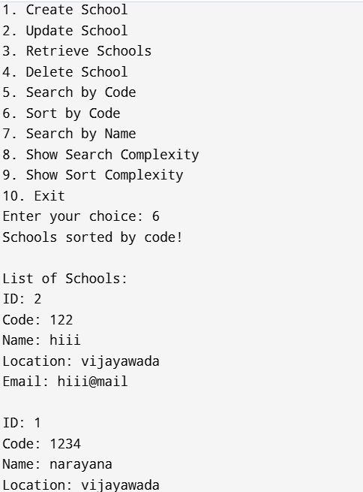
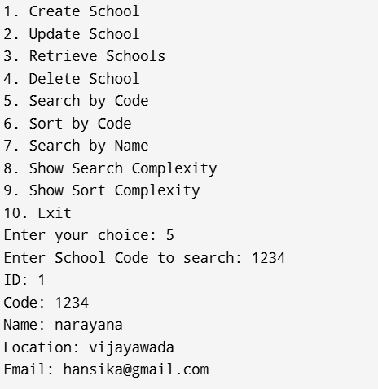
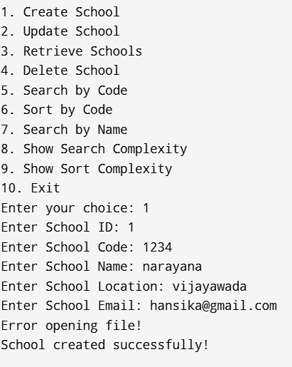
SAMPLE OUTPUTS

Slide 16
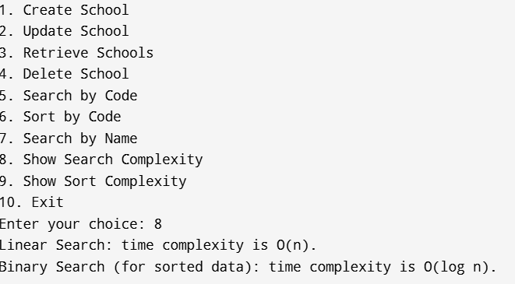
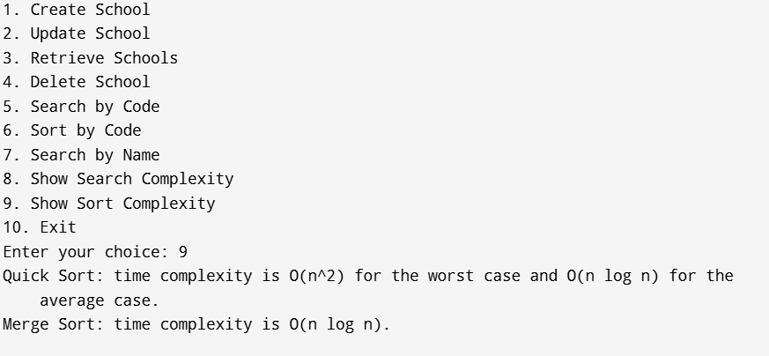

Slide 17
CONCLUSION
This project creates a simple and effective system to manage bloom level data, allowing users to store, view, update, and delete information as needed. To keep data organized and easy to find, the program includes sorting and searching methods. Merge Sort is used for its steady and reliable performance, while Quick Sort provides faster sorting for unsorted data. For searching, Binary Search is used for quick lookups on sorted data, and Linear Search allows for flexible searches on unsorted data.
Overall, the project efficiently handles data operations and keeps information saved in a file, making sure that changes are kept even after the program closes. This project demonstrates basic principles of data management, showing how to choose and use different algorithms based on specific needs to create a reliable system for managing bloom level data.

Slide 18
Thank you very much!

